Slide 1
Yellow Ball
Green Ball
5-6 year olds
6 min
Notes:
- idk/silent → I know this is a pretty tricky question huh? But if you had to choose, [repeat question] You know, there are no right or wrong answers in this game. Anything you say is good. [repeat question]
- Irrelevant comments/Persists with q → Well let’s talk about that after the game, for now I just want to know… (repeat question with item in question) *try to get back to their question after the study is done*
- Answers early → Oh, and one of the rules of this game is that I have to finish my whole question before you answer, ok?

Slide 2
Notes:
**Bing: I’m going to turn the camera on to take a picture of us so that we can remember the game later. I’m going to take your name tag off and put it right here, and we’ll put it back on when you go back to the classroom. I’m putting it right here, so don’t let me forget. And if you want to stop and go back to the classroom, just let me know, okay?
**Museum: I turned the voice recorder on so that I can remember how we played game later. If you want to stop at any time, just let me know, okay?

Slide 3


Slide 4
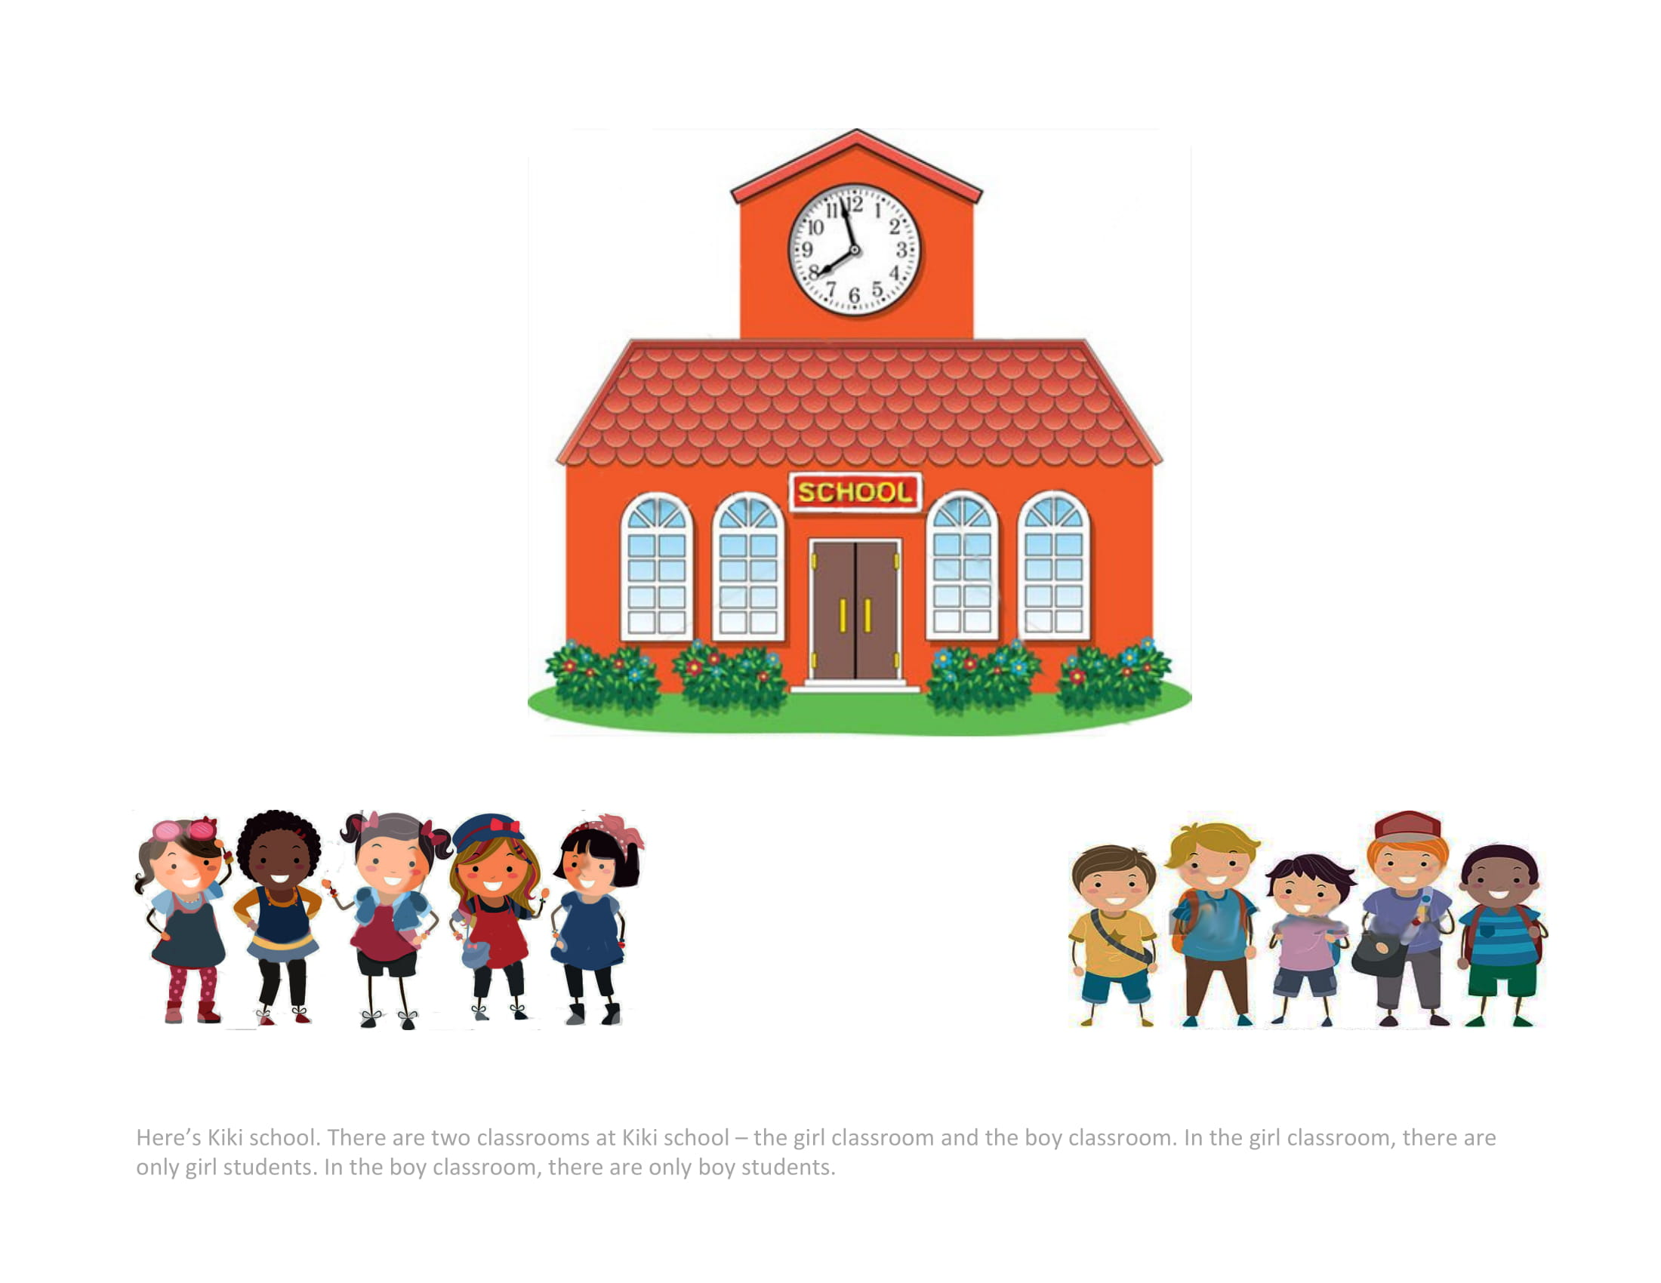
Notes:
Here's Kiki school. There are two classrooms at Kiki school - the girl classroom and the boy classroom. In the girl classroom, there are only girl students. In the boy classroom, there are only boy students.

Slide 5
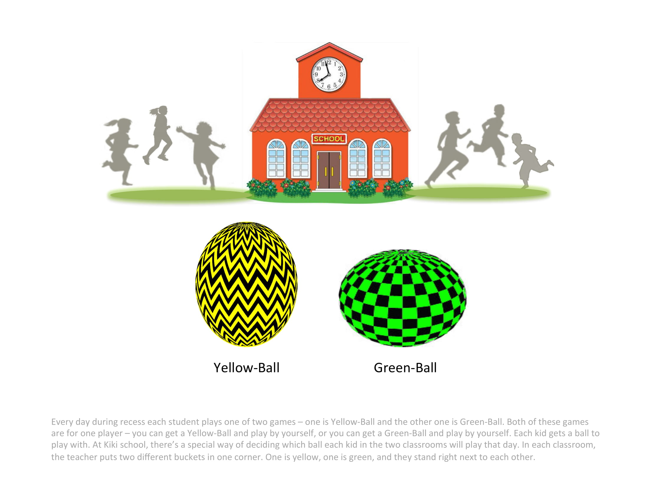
Notes:
Every day during recess each student plays one of two games – one is Yellow-Ball and the other one is Green-Ball. Both of these games are for one player – you can get a Yellow-Ball and play by yourself, or you can get a Green-Ball and play by yourself. Each kid gets a ball to play with. At Kiki school, there’s a special way of deciding which ball each kid in the two classrooms will play that day. In each classroom, the teacher puts two different buckets in one corner. One is yellow, one is green, and they stand right next to each other.

Slide 6
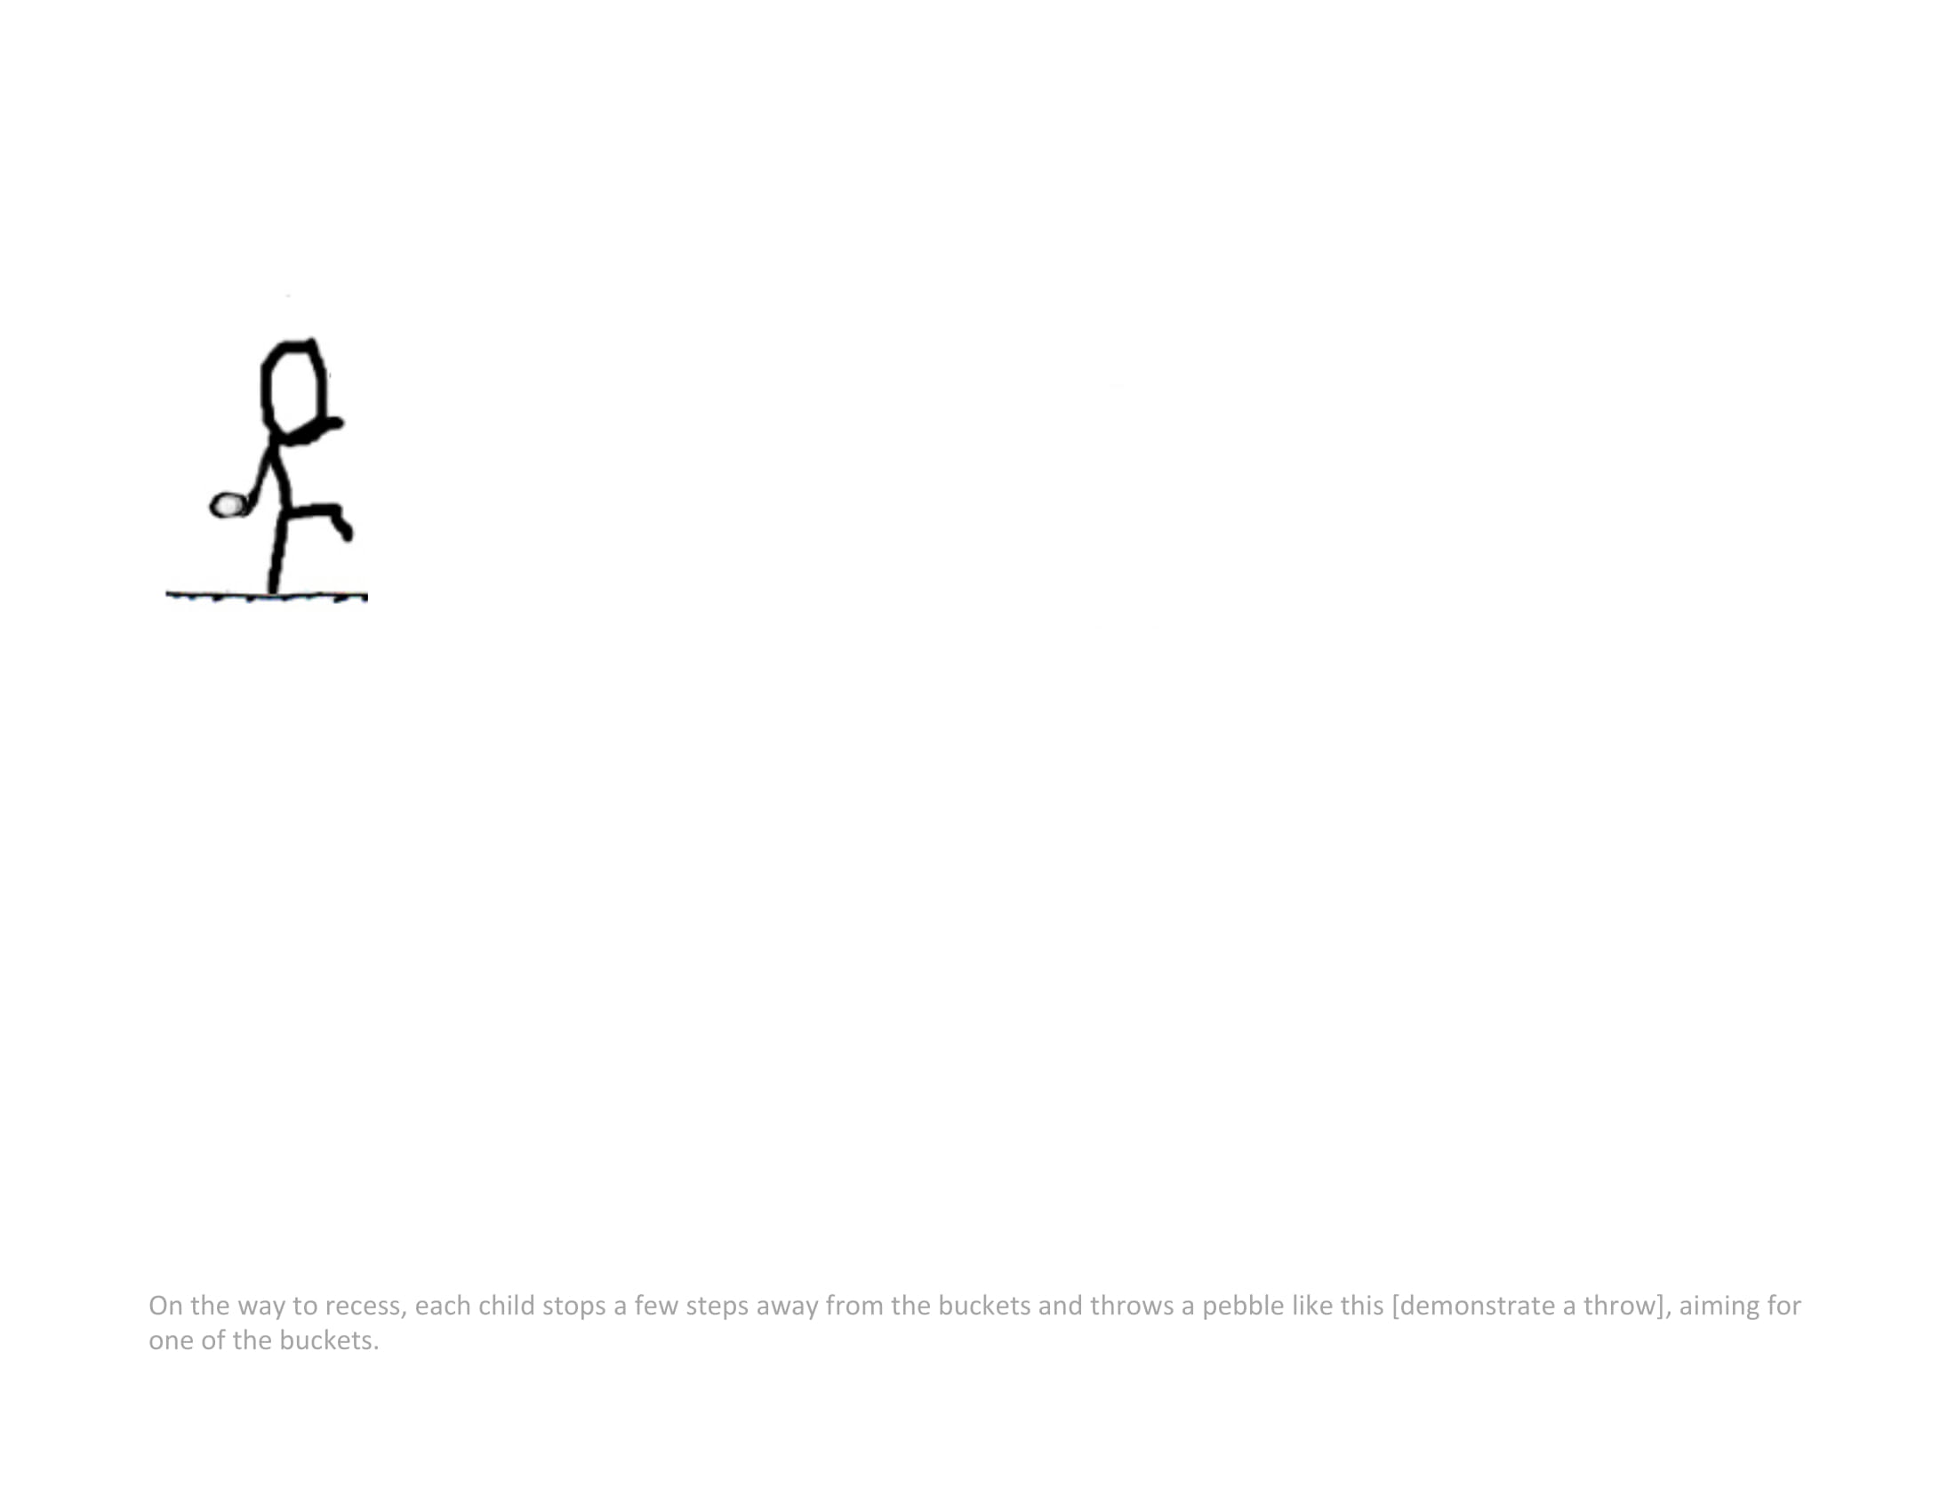
Notes:
On the way to recess, each child stops a few steps away from the buckets and throws a pebble like this [demonstrate a throw], aiming for one of the buckets.

Slide 7
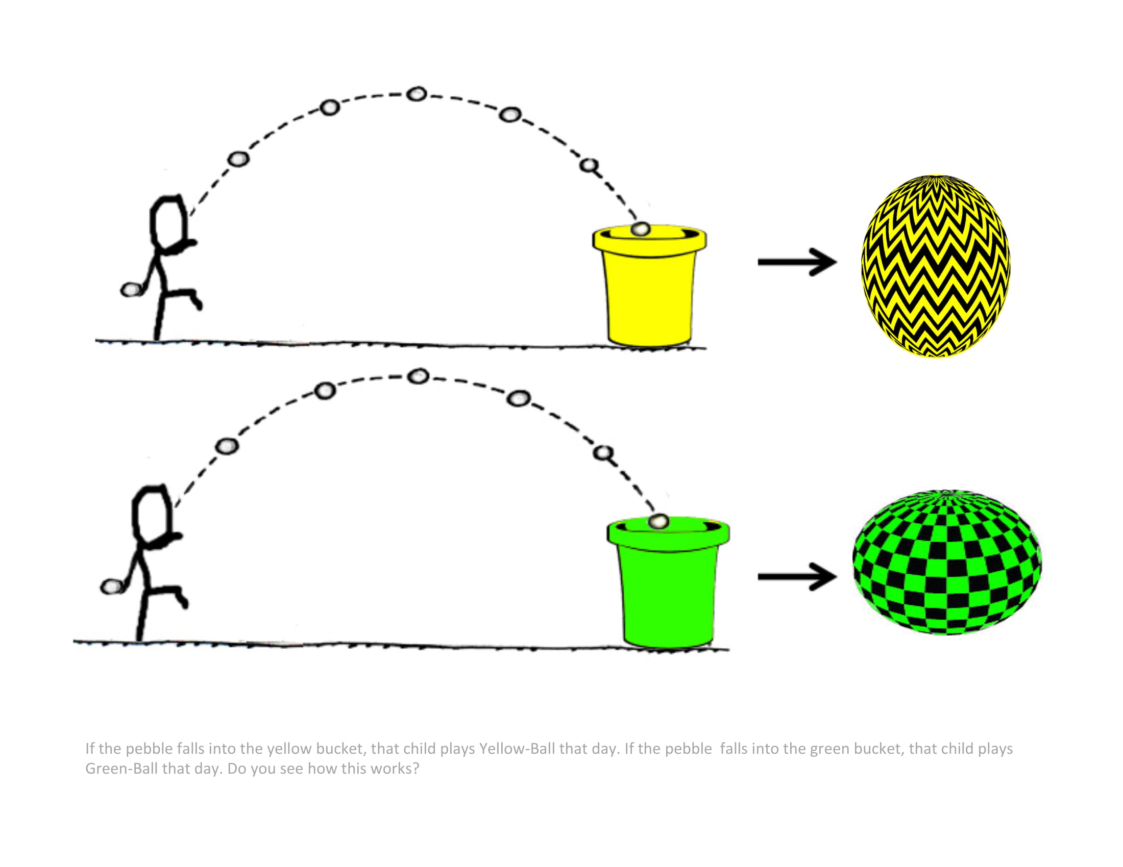
Notes:
If the pebble falls into the yellow bucket, that child plays Yellow-Ball that day. If the pebble, falls into the green bucket, that child plays Green-Ball that day. Do you see how this works?

Slide 8
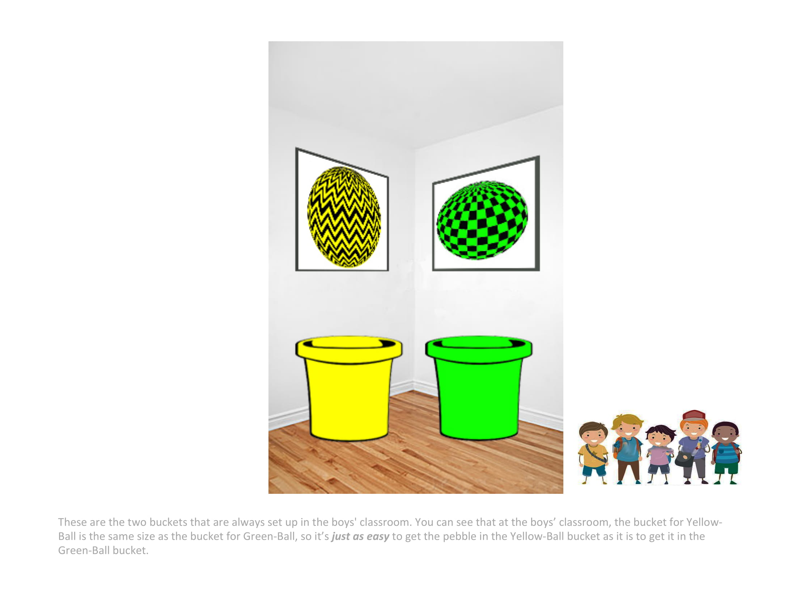
Notes:
These are the two buckets that are always set up in the boys' classroom. You can see that at the boys’ classroom, the bucket for Yellow-Ball is the same size as the bucket for Green-Ball, so it’s just as easy to get the pebble in the Yellow-Ball bucket than it is to get it in the Green-Ball bucket.

Slide 9
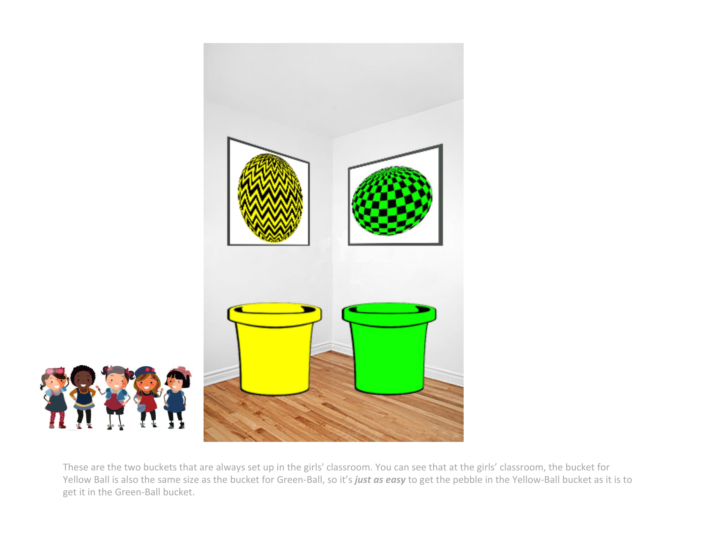
Notes:
These are the two buckets that are always set up in the girls' classroom. You can see that at the girls’ classroom, the bucket for Yellow-Ball is also the same size as the bucket for Green-Ball, so it’s just as easy to get the pebble in the Yellow-Ball bucket than it is to get it in the Green-Ball bucket.

Slide 10
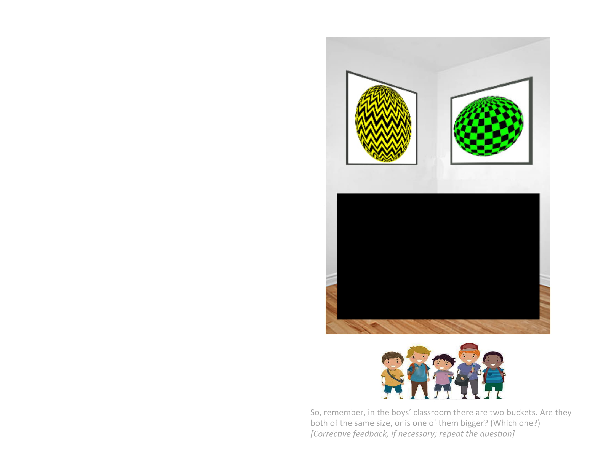
Notes:
So, remember, in the boys’ classroom there are two buckets.
*Are they both of the same size, or is one of them bigger? [Corrective feedback if necessary; repeat the question]

Slide 11
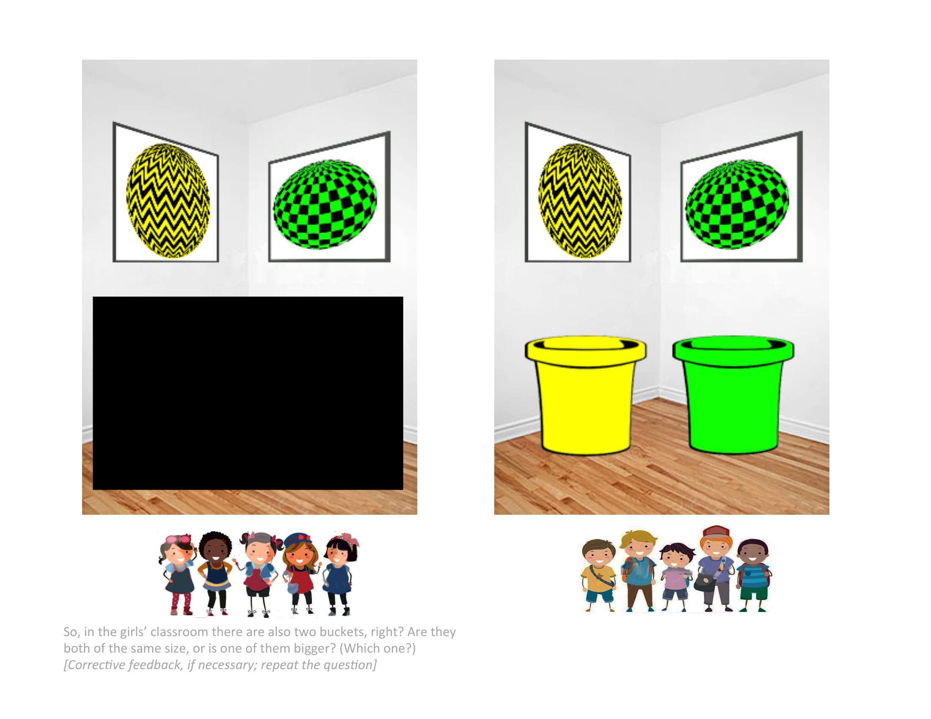
Notes:
Right, they’re the same size!

Slide 12
Notes:
So, in the girls’ classroom there are also two buckets, right?
**Are they both of the same size, or is one of them bigger? Which one? [Corrective feedback if necessary; repeat the question]

Slide 13
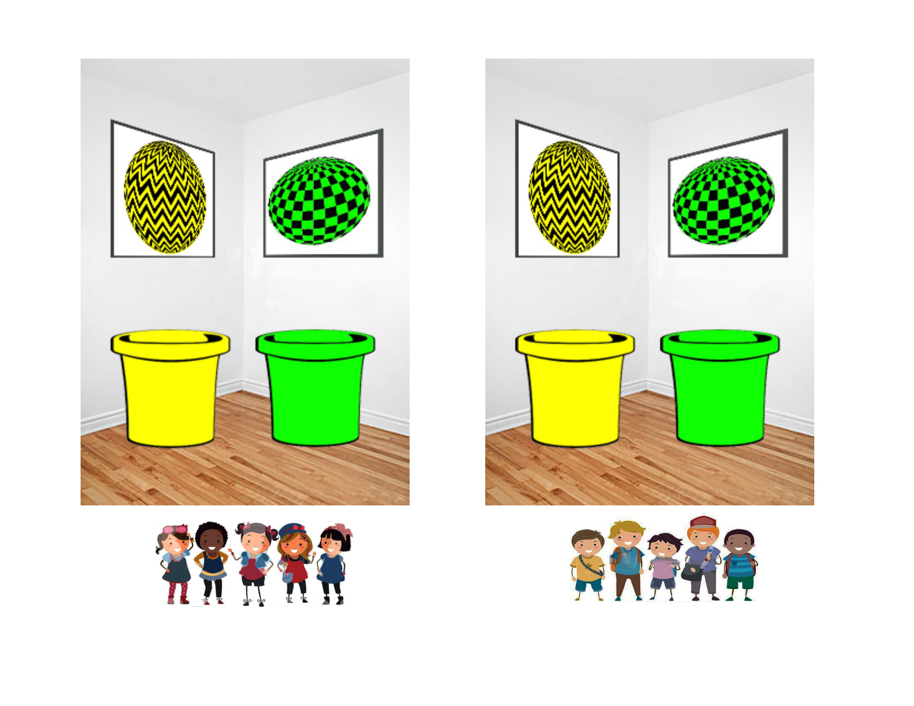

Slide 14
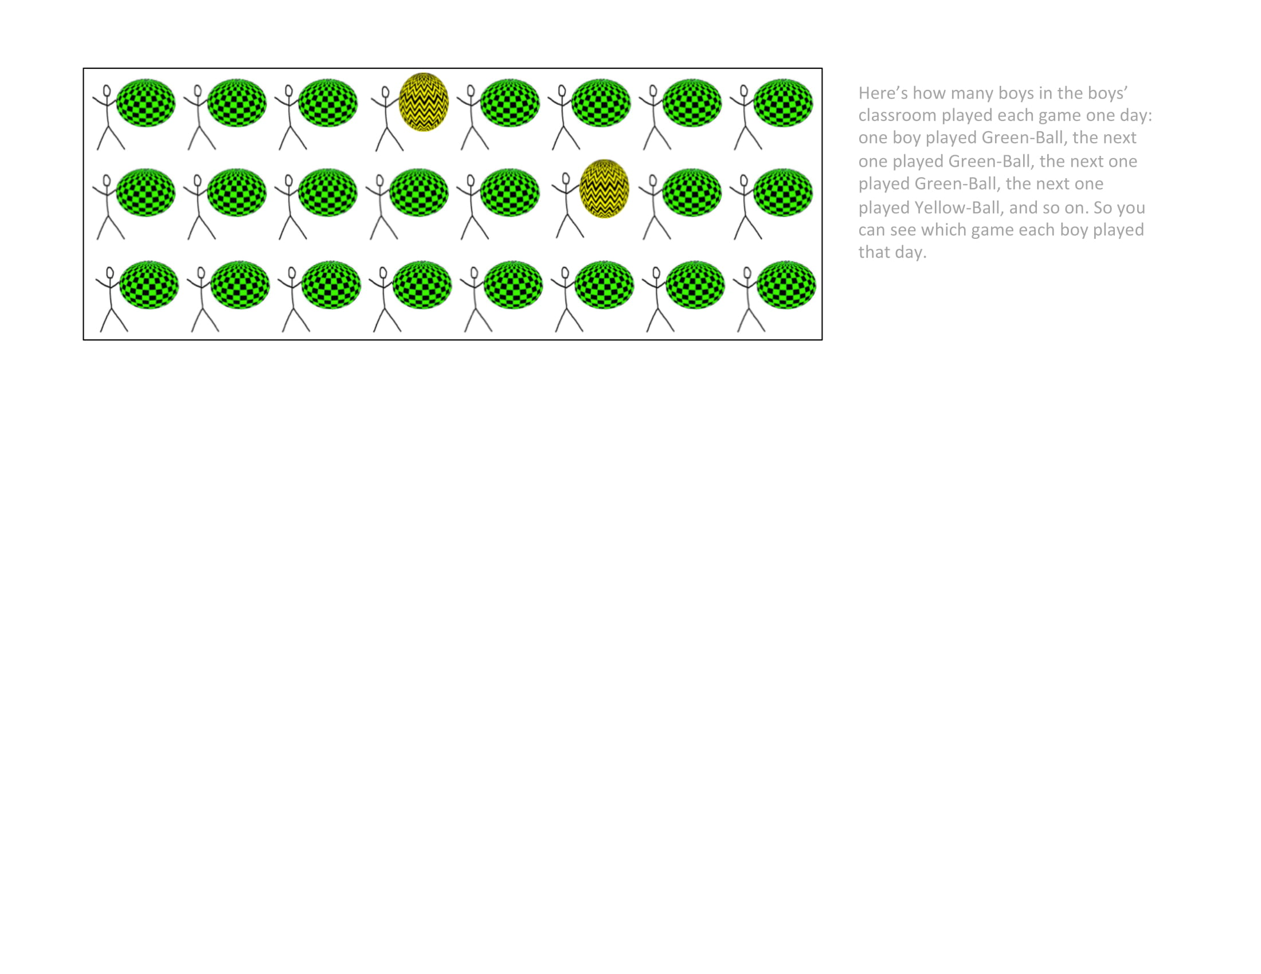
Notes:
Here’s how many boys in the boys’ classroom played each game one day: one boy played Green-Ball, the next one played Green-Ball, the next one played Green-Ball, the next one played Yellow-Ball, and so on. So you can see which game each boy played that day.

Slide 15
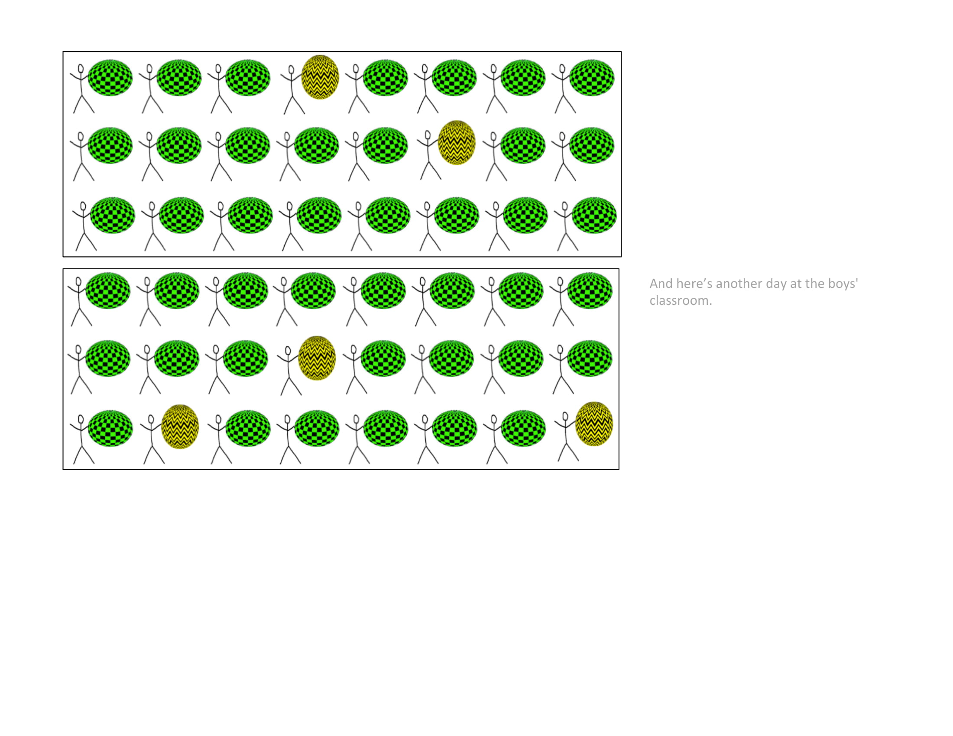
Notes:
And here's another day at the boys' classroom.

Slide 16
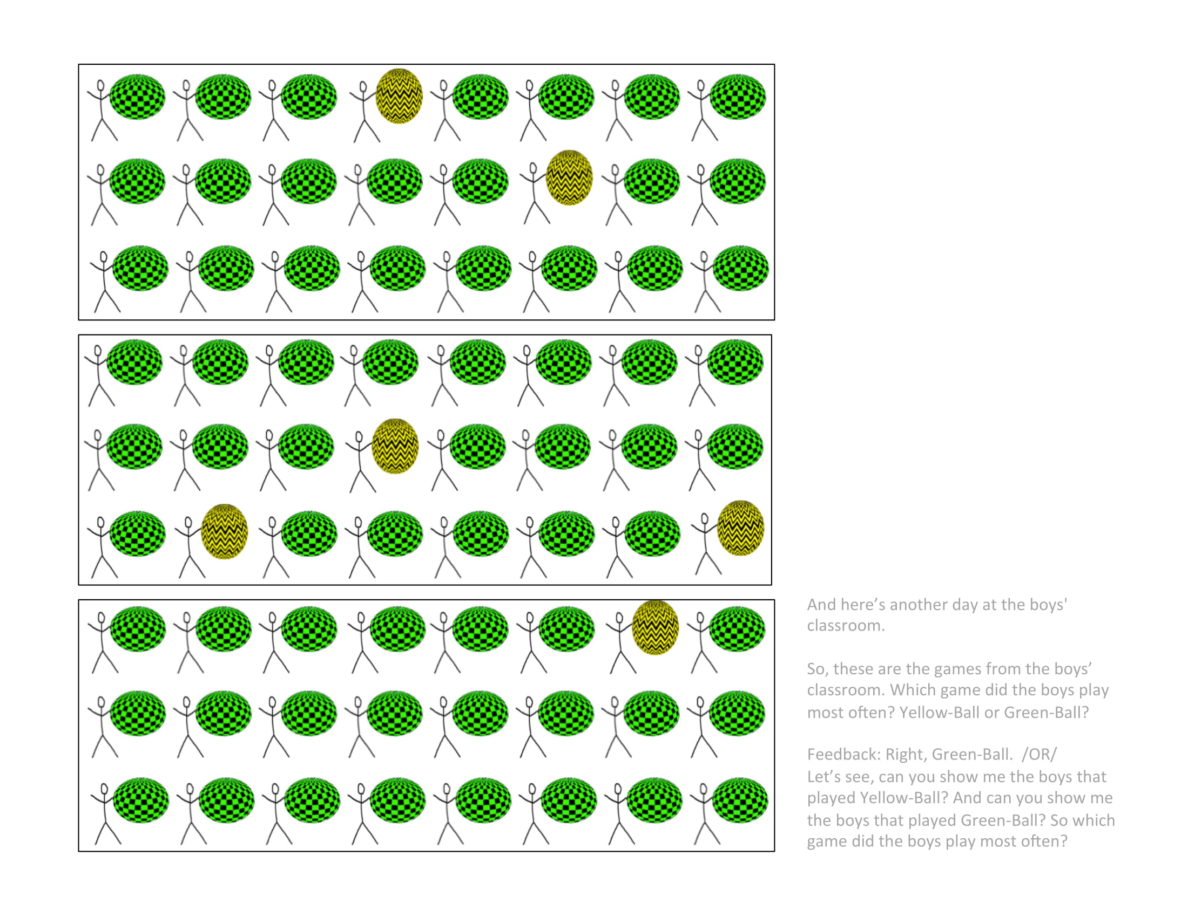
Notes:
And here's another day at the boys' classroom.
**So, there are the games from the boys' classroom. Which game did the boys play most often? Yellow-Ball or Green-Ball?
Feedback: Right, Green-Ball. /OR/ Let’s see, can you show me the boys that played Yellow-Ball? And can you show me the boys that played Green-Ball? So which game did the boys play most often?

Slide 17
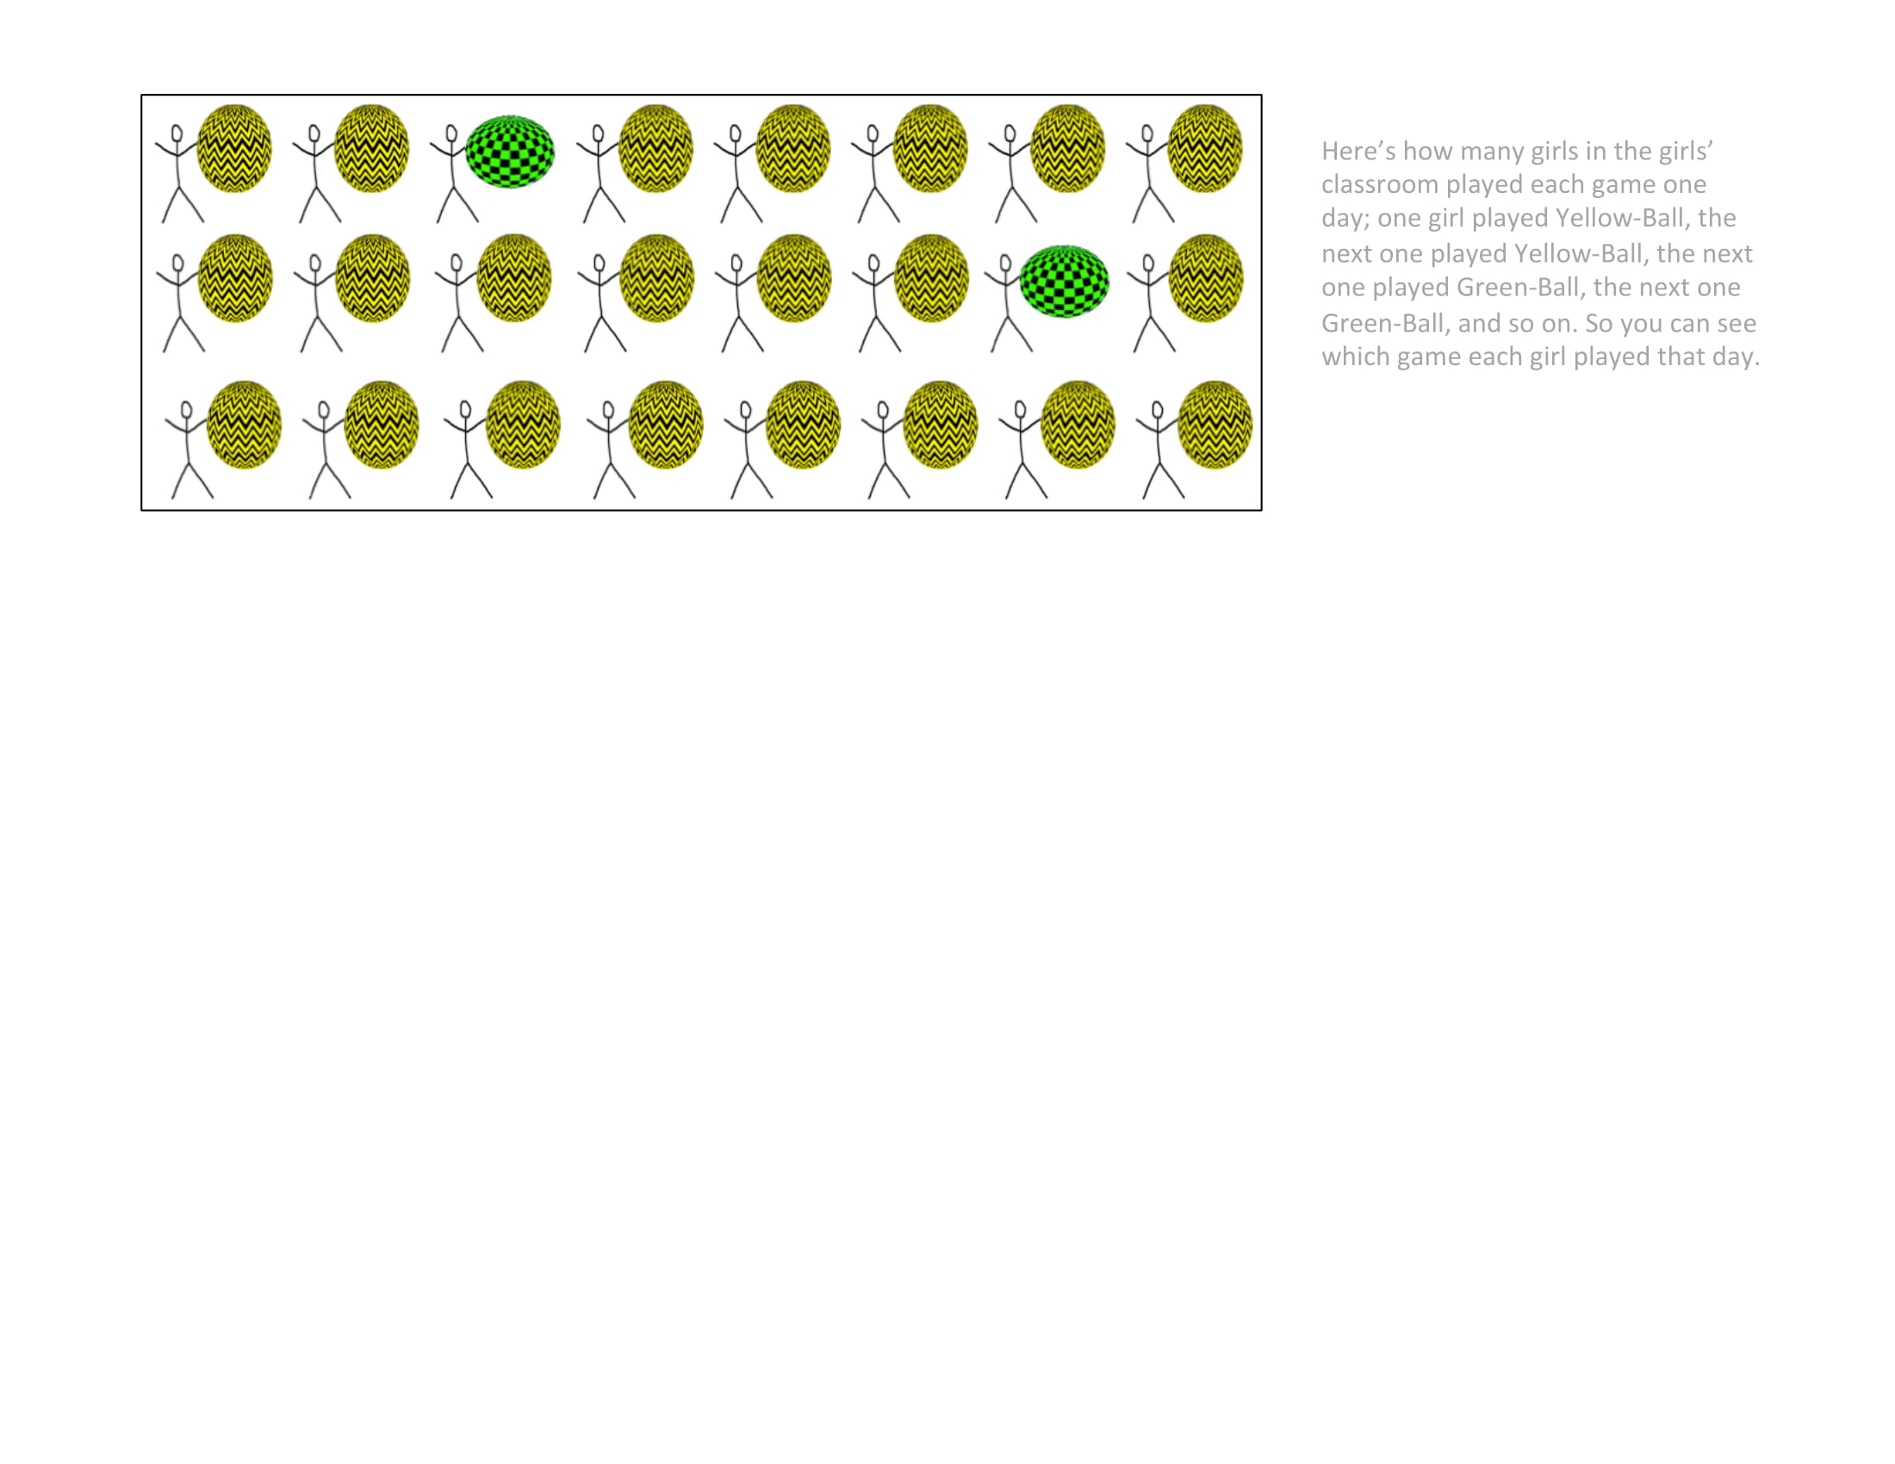
Notes:
Here’s how many girls in the girls’ classroom played each game one day; one girl played Yellow-Ball, the next one played Yellow-Ball, the next one played Green-Ball, the next one Yellow-Ball, and so on. So you can see which game each girl played that day.

Slide 18
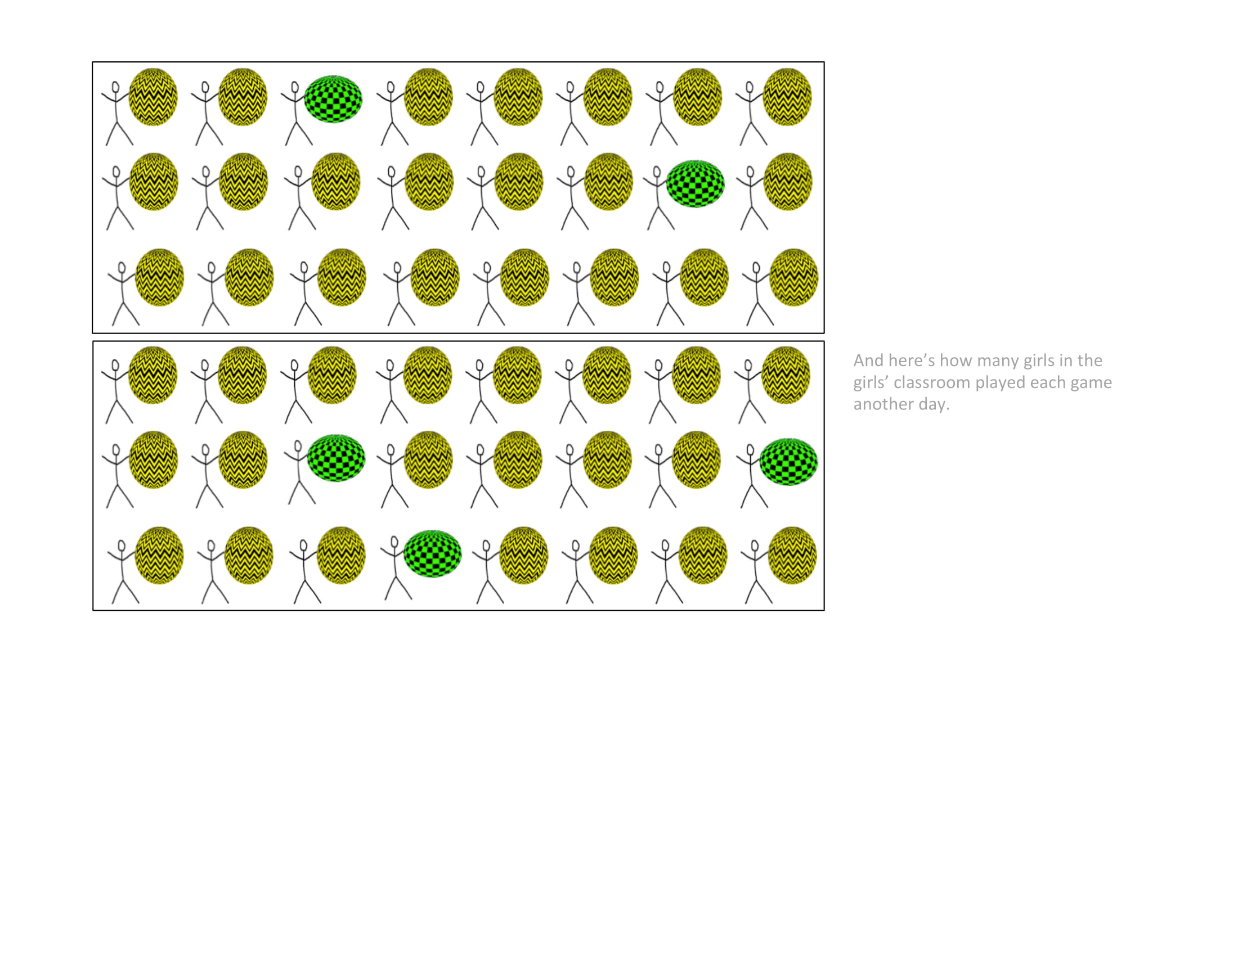
Notes:
And here's how many girls in the girls' classroom played each game another day.

Slide 19
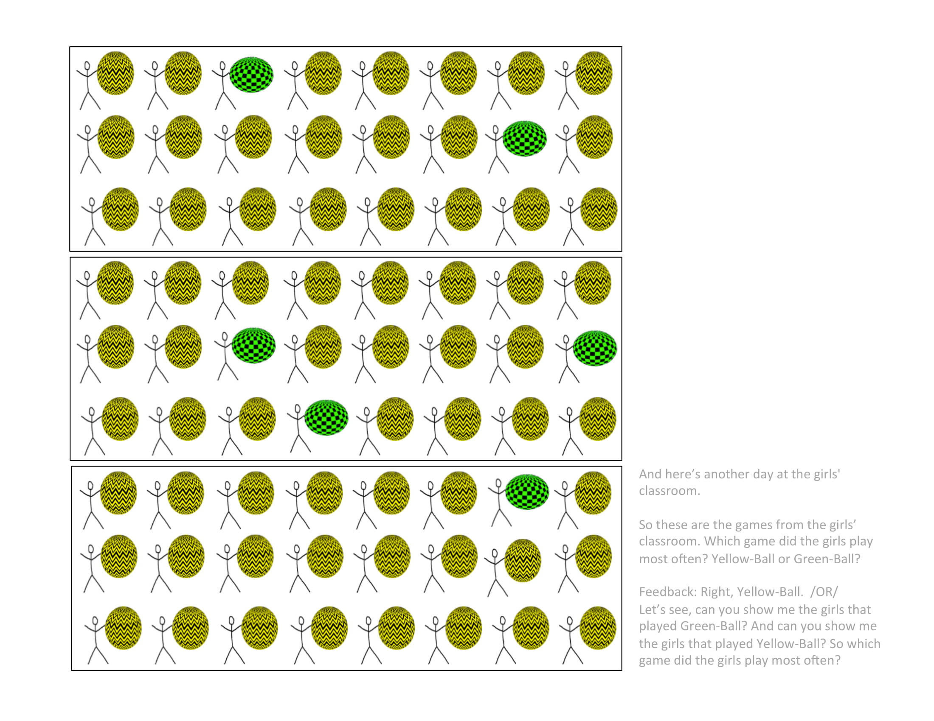
Notes:
And here's another day at the girls' classroom.
**So these are the games from the girls' classroom. Which game did the girls play most often? Yellow-Ball or Green-Ball?
Feedback: Right, Yellow-Ball. /OR/ Let’s see, can you show me the girls that played Green-Ball? And can you show me the boys that played Yellow-Ball? So which game did the girls play most often?

Slide 20
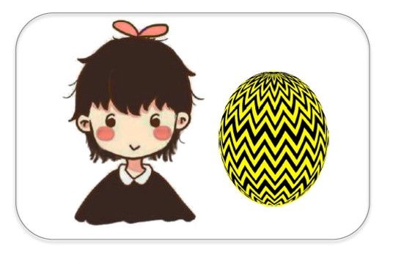
Here’s Suzy. She is a girl. She plays Yellow-Ball.
Notes:
Here’s Suzy. She is a girl. She plays Yellow-Ball.

Slide 21
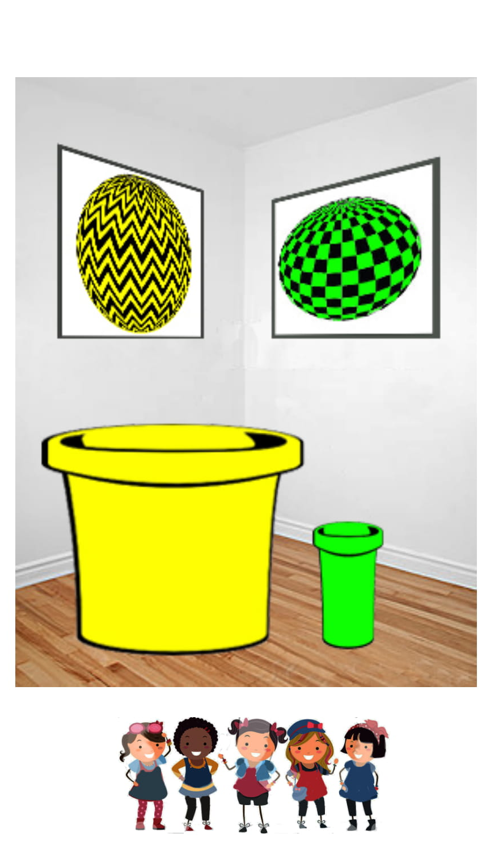
So, Suzy plays Yellow-Ball a lot. Is it because Suzy likes playing Yellow-Ball, or is it because of the size of the buckets in her classroom?
Notes:
*Indiv: So, Suzy plays Green-Ball a lot. *Indiv original: Is it because Suzy likes playing Green-Ball, or is it because of the buckets in her classroom?
*Indiv adjusted: Is it because Suzy likes playing Green-Ball, or is it because of the size of the buckets in her classroom?
*Group: So, the girls in the girls’ classroom play Green-Ball a lot at their school, and the boys in the boys’ classroom play Yellow-Ball a lot at their school. Is it because girls and boys like playing with different balls, or is it because of the buckets in their classrooms?

Slide 22
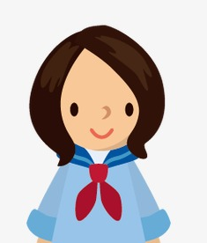
Here’s Lucy. Lucy is a girl who doesn’t go to Kiki school. She goes to a different school where there aren’t any buckets.
Notes:
Here’s Lucy. Lucy is a girl who doesn’t go to Kiki school. She goes to a different school where there aren’t any buckets.
Let’s show Lucy a Yellow-Ball and a Green-Ball. What game do you think Lucy will play? ___ For sure __ or maybe __?

Slide 23
Let’s show Lucy a Yellow-Ball and a Green-Ball. What game do you think Lucy will play? For sure or maybe __?
Notes:
Here’s Lucy. Lucy is a girl who doesn’t go to Kiki school. She goes to a different school. Let’s show Lucy a Yellow-Ball and a Green-Ball. What game do you think Lucy will play? ___ For sure __ or maybe __?

Slide 24
Would it be okay or not okay for girls to play Green-Ball?
Notes:
Group: Would it be okay or not okay for girls to play Yellow-Ball?
Indiv: Here’s Katie. Katie is a girl who plays Yellow-Ball. Is it okay or not okay for Katie to play Yellow-Ball? (okay/not okay)

Slide 25
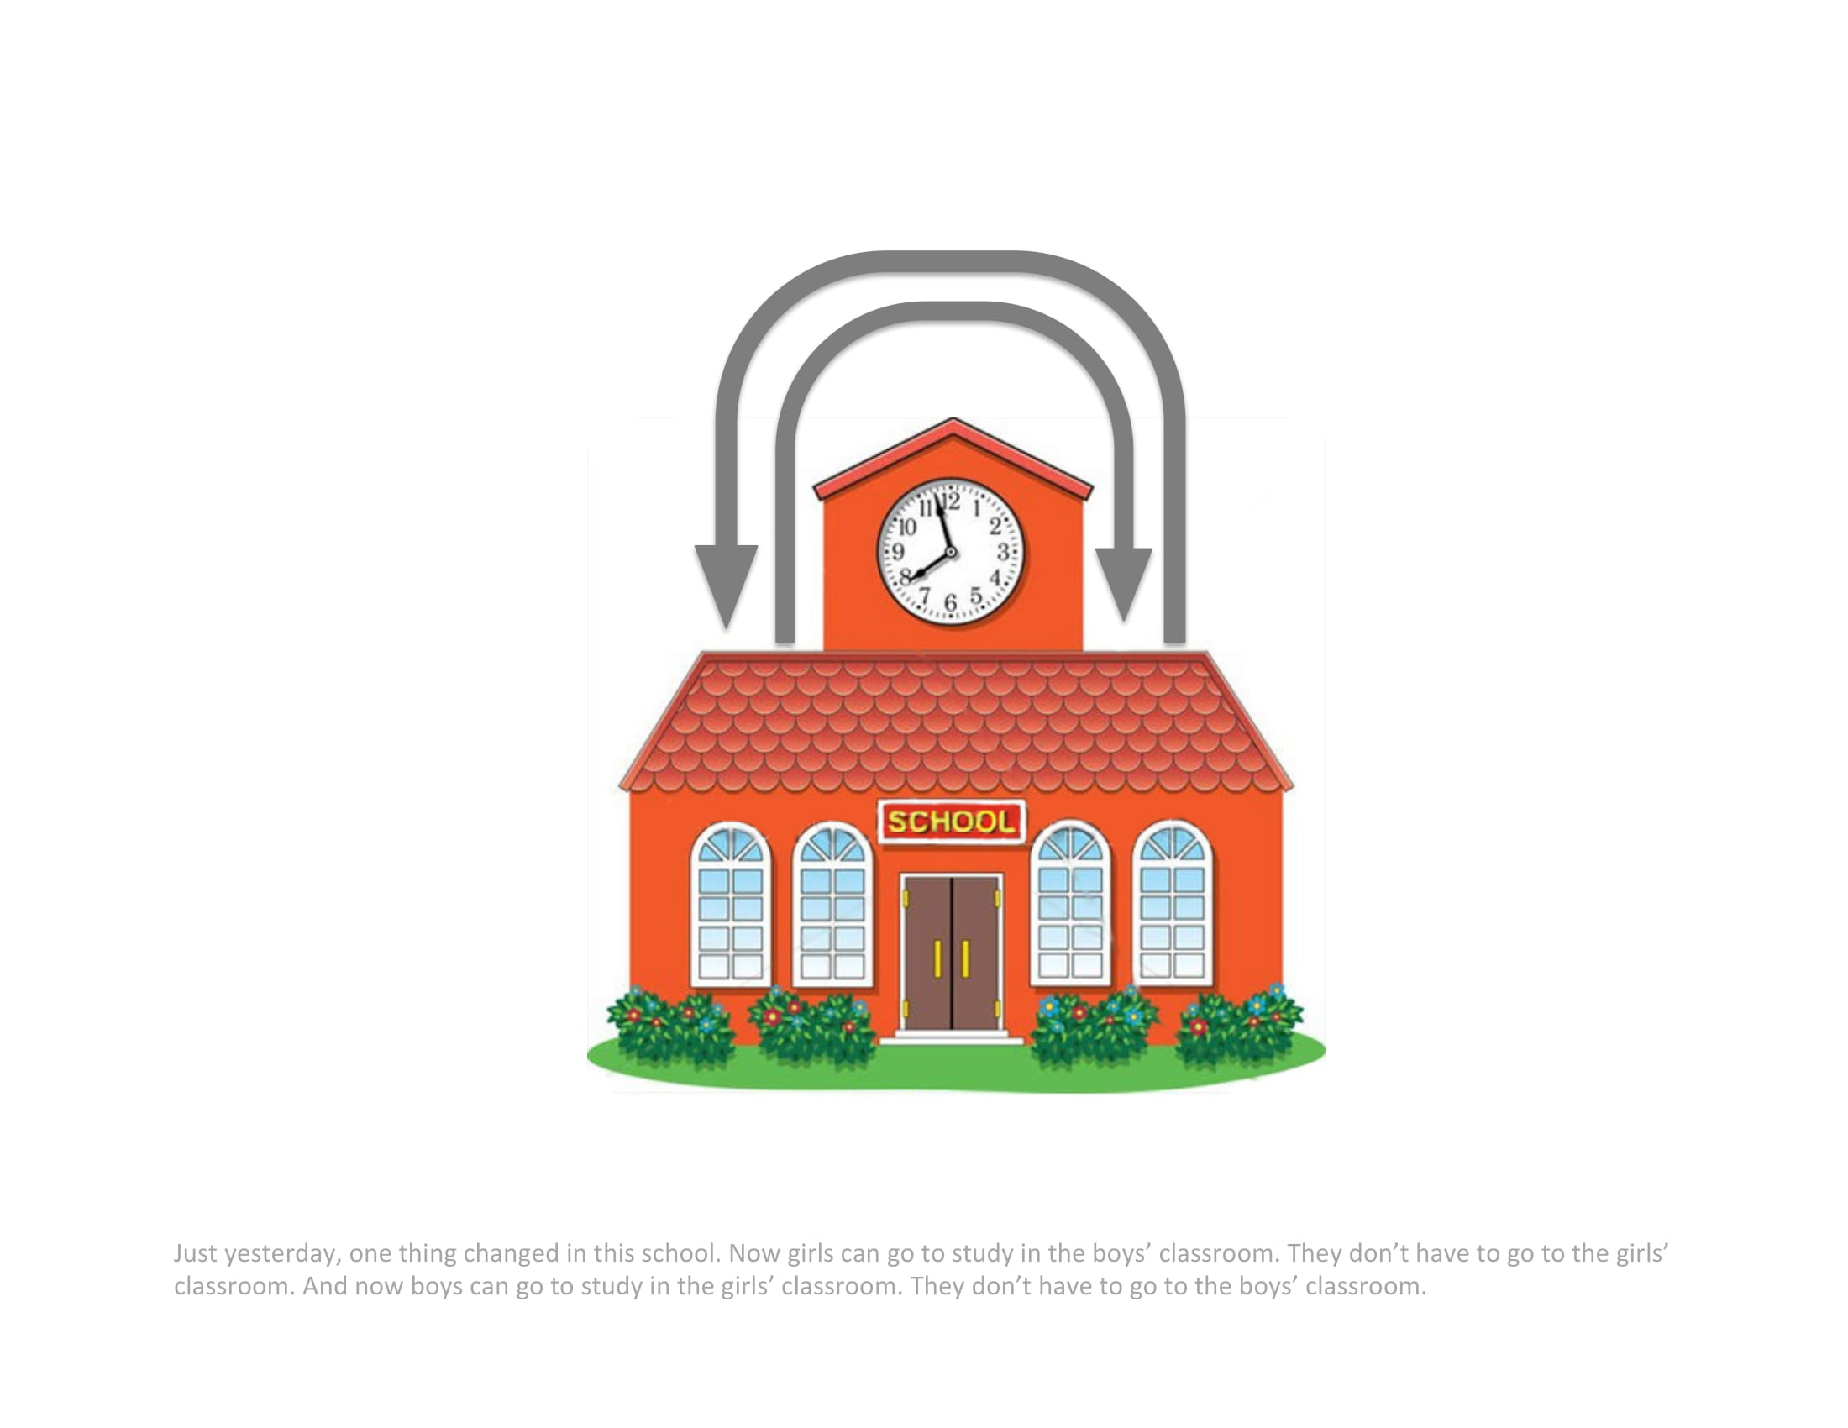
Notes:
Just yesterday, one thing changed in this school. Now girls can go to study in the boys’ classroom. They don’t have to go to the girls’ classroom. And now boys can go to study in the girls’ classroom. They don’t have to go to the boys’ classroom.

Slide 26
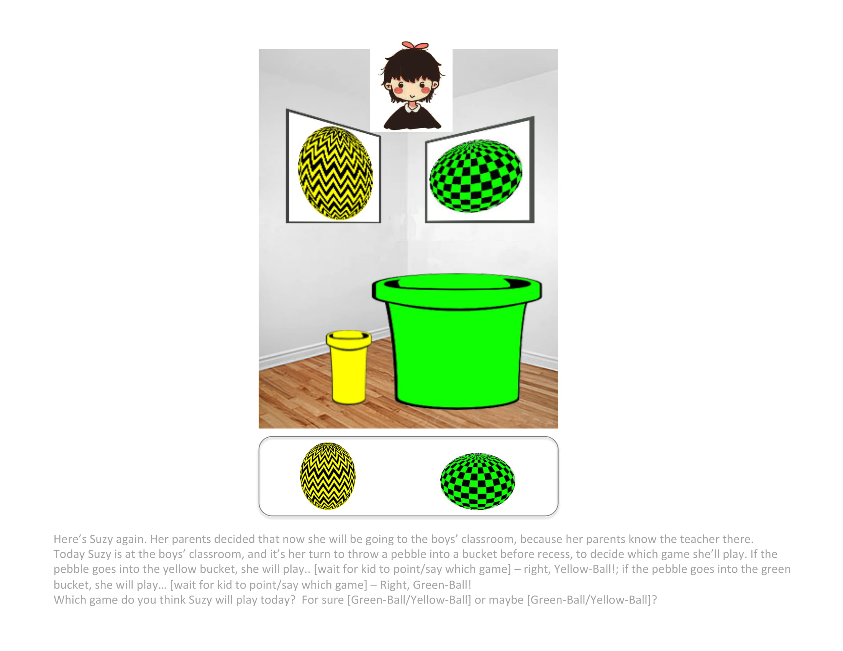
Notes:
Here’s Suzy again. Her parents decided that now she will be going to the boys’ classroom, because her parents know the teacher there. Today Suzy is at the boys’ classroom, and it’s her turn to throw a pebble into a bucket before recess, to decide which game she’ll play.
If the pebble goes into the yellow bucket, she will play… [wait for kid to point/say which game] – right, Yellow-Ball! If the pebble goes into the green bucket, she will play… [wait for kid to point/say which game] – right, Green-Ball!
**Which game do you think Suzy will play today? For sure [Green-Ball / Yellow-Ball] or maybe [Green-Ball/Yellow-Ball]?

Slide 28
Age | Pilot | Final sample | Excluded
5 | FYP_20190205_02_nonstr_control_girlsYellow.mp4 |  | FYP_20190205_01_nonstr_control_girlsYellow.mp4
6

